Slide 1
L.O – To retell the story of Pentecost

Slide 2
Starter Activity
On a piece of paper, list as many different languages as possible!!
TIP . . .
There are over 6,500 language spoken in the world today!

Slide 3
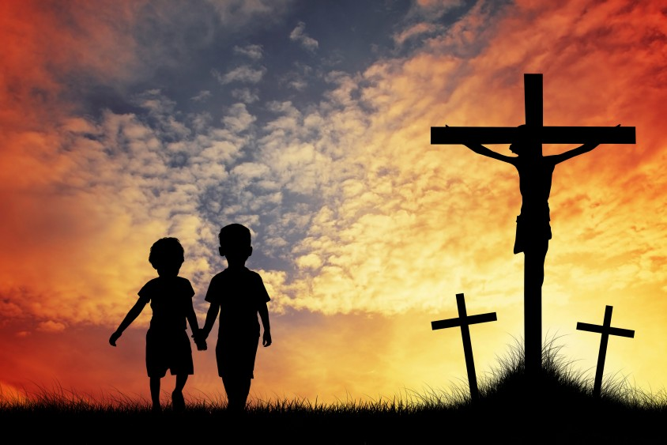
The story of Pentecost is set just 10 days after Jesus was crucified . . .

Slide 4
Part 1
The Apostles (followers of Jesus), were all together in one place. It was ten days after Jesus had gone to Heaven. Before he left, he had made them a promise . . .
“The Holy Spirit will come to you. He will give you power to tell people about me.”

Slide 5
Part 2
For ten days, the Apostles and some other followers of Jesus had stayed together, praying and waiting. But now the great day had come! Suddenly, a noise like a strong wind filled the whole house and the followers saw something that looked like flames of fire, falling on each person there. They were all filled with the Holy Spirit, and they began to speak different languages.

Slide 6
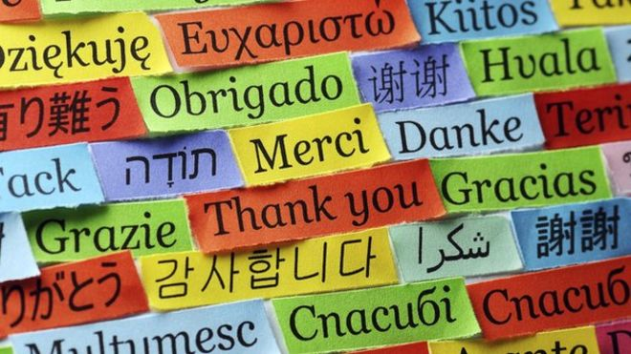
Part 3
At that time Jerusalem was full of Jewish visitors from all over the world. They were all surprised, because each one of them heard the Apostles speaking in his own language. They were completely amazed at this.

Slide 7
Part 4
They said, "Look! Aren't all these men that we hear speaking from Galilee?... But we hear these men telling in our own languages about the great things God has done!" But others made fun of the Apostles, saying, "They have drunk too much wine."
But Peter stood up with the eleven apostles. In a loud voice he spoke to the crowd: "Listen to me. Pay attention to what I have to say. These men are not drunk, as you think; it is only nine o'clock in the morning!"

Slide 8
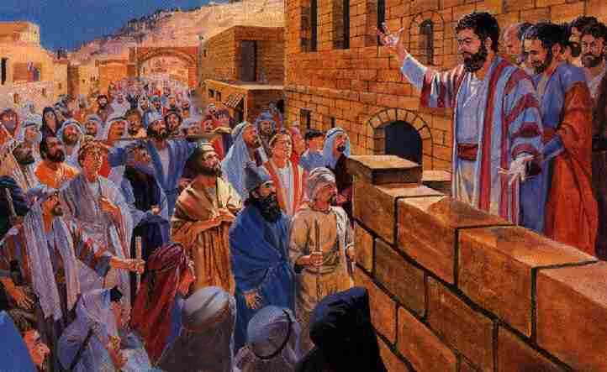
Part 5
Then Peter made a long speech, telling the crowds all about Jesus.

Slide 9
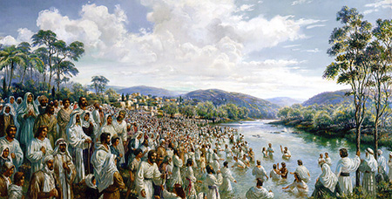
Part 6
That day, about 3,000 people became followers of Jesus and were baptised. They spent the rest of their time in Jerusalem learning all about Jesus from the Apostles before returning home. And the Apostles continued to meet together to pray and to break bread.

Slide 10
Over to you!
Create a comic strip to re-tell the story of Pentecost.
You can look back at the different parts of the story to help you.
EXTENSION
God gave the Apostles the power to speak in different language. Write 5 sentences about the powers God has given you. (e.g, God has given me the ability to play the guitar).

